Slide 1


Computer Concepts 2018
Module 3 Networks
Copyright © 2019 Cengage. All rights reserved.

Slide 2
Module Contents
Section A: Network Basics
Section B: The Internet
Section C: Internet Access
Section D: Local Area Networks
Section E: File Sharing

Slide 3
Section A: Network Basics
Communication Systems
Communication Channels
Network Topology
Network Nodes
Communication Protocols

Slide 4
Section A: Objectives (1 of 2)
Replicate Shannon’s diagram of a general communication system, including all nine labels
Give two examples of PANs, LANs, and WANs
List four examples of wired channels used for networks
State the two wireless channels most commonly used for communication networks
List two advantages and four disadvantages of wireless channels
State what differentiates broadband from narrowband

Slide 5
Section A: Objectives (2 of 2)
Draw a diagram showing how data from a smart thermostat could travel over several networks with different topologies
Compare and contrast mesh and star topologies based on dependability, security, capacity, expandability, control, and monitoring
List two examples of DTEs and two examples of DCEs
Explain the difference between a modem and a router
List five tasks that are handled by communication protocols

Slide 6
Communication Systems (1 of 5)
Networks can be classified in many ways; as a network user, you’ll want to keep in mind the idea of control and how it affects your privacy and security
A network links things together
A communication network (or communication system) links together devices to data and information can be shared among them

Slide 7
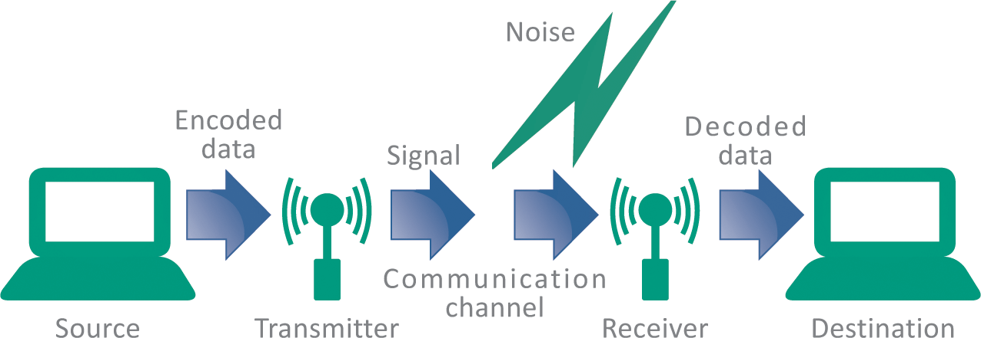
Communication Systems (2 of 5)
In 1948, Claude Shannon, an engineer at Bell Labs, published and article describing a communication system model applicable to networks of all types
His diagram illustrates the essence of a network

Slide 8
Communication Systems (3 of 5)
Networks can be classified according to their size and geographic scope
PAN (personal area network)
PANs connect smart devices or consumer electronics within a range of about 30 feet (10 meters) and without the use of wires or cables. The reference to personal indicates that the network serves a single individual, rather than multiple users. A PAN could be used to sync data from a handheld device to a desktop computer, ship data wirelessly to a printer, or transmit data from a smartphone to a wireless headset.

Slide 9
Communication Systems (4 of 5)
LAN (local area network)
LANs are data communication networks that connect personal computers within a very limited geographical area—usually a single building. School computer labs and home networks are examples of LANs. Wi-Fi networks that you can access in airports, coffee shops, and other public places are LANs. The in-house networks operated by most businesses are also LANs.

Slide 10
Communication Systems (5 of 5)
WAN (wide area network)
WANs cover a large geographical area and usually consist of several smaller networks, which might use different computer platforms and network technologies. The Internet is the world’s largest WAN. Other public WANs include telephone systems, cable television systems, and satellite based communication systems.

Slide 11
Communication Channels (1 of 10)
A communication channel is the medium used to transport information from one network device to another
Wired channels transport data through wires and cables
Wireless channels transport data from one device to another without the use of cable or wires

Slide 12
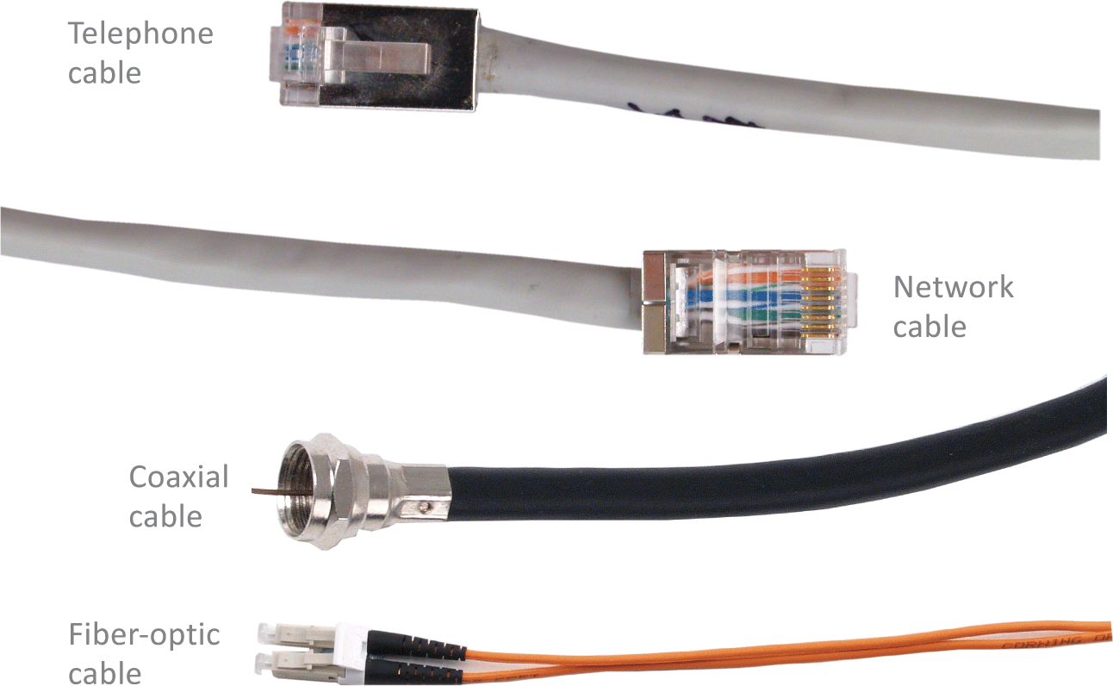
Communication Channels (2 of 10)
Wired channels include twisted pair wires used for telephone land lines, coaxial cables used for cable television networks, Category 6 cables used for LANs, and fiber-optic cables used for high-capacity trunk lines

Slide 13
Communication Channels (3 of 10)
When you set up a wired connection, you don’t have to worry about hackers intercepting your data from outside your house
There are ways to tap into a wired network, but they require physical access to the cable or fairly sophisticated snooping equipment

Slide 14
Communication Channels (4 of 10)
Cables can be shielded against interference and encased in protective casings for installations that are outdoors and underground.
Wired connections are dependable. Their carrying capacity and speed are not affected by airborne interference from rain, snow, or electrical devices.
Wired connections are more secure than their wireless counterparts because a device can join a wired network only if it is physically connected by a cable.

Slide 15
Communication Channels (5 of 10)
In WANs, wired installation can be costly because cables have to be suspended from poles or buried underground. They can be damaged by weather events and digging in the wrong place. Repairs to underground cables require heavy equipment to locate, access, and fix the break.
LAN devices connected by cables have limited mobility. Desktop computers tend to be better candidates for wired connections, whereas laptops, tablets, and handheld devices can retain their mobility when they are not tethered to a cable.
Cables are unsightly, tend to get tangled, and collect dust. Running cables through ceilings, walls, and floors can be challenging. Cables can also carry electrical surges that have the potential to damage network equipment.

Slide 16
Communication Channels (6 of 10)
The most widespread wireless channels for communication networks are radio signals and microwaves
Most wireless channels transport data as RF signals commonly called radio waves
RF signals are sent and received by a transceiver (a combination of a transmitter and a receiver) that is equipped with an antenna

Slide 17
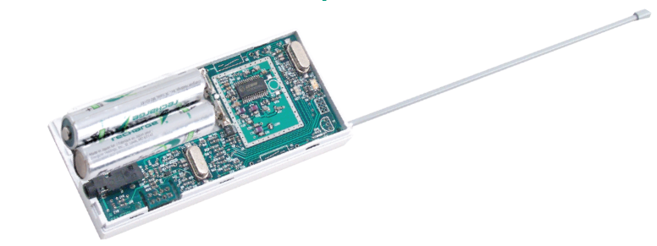
Communication Channels (7 of 10)
Devices used with wireless connections are equipped with transceivers that include a transmitter for sending data and a receiver for collecting data. A transceiver has an antenna, which may be visible or may be housed out of sight within a device’s system unit.

Slide 18
Communication Channels (8 of 10)
Microwaves (the waves themselves, not your oven!) provide another option for transporting data wirelessly
Microwaves are electromagnetic signals that can be aimed in a single direction and have more carrying capacity than radio waves
Microwave installations usually provide data transport for large corporate networks

Slide 19
Communication Channels (9 of 10)
Advantages of wireless
Mobility
No unsightly cables
Less susceptible to power spikes
Disadvantages of wireless
Speed
Range
Security
Licensing

Slide 20
Communication Channels (10 of 10)
Bandwidth is the transmission capacity of a communication channel
Network channels that are capable of moving at least 25 megabits of data per second (25 Mbps) are classified as broadband
Channels slower than 25 Mbps are classified as narrowband

Slide 21
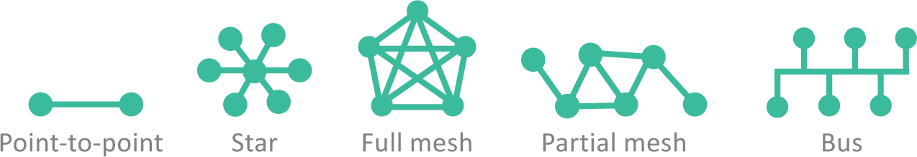
Network Topology (1 of 2)
In the context of communication networks, topology refers to the structure and layout of network components, such as computers, connecting cables, and wireless signal paths
Point-to-point topology refers to the process of peripheral devices connecting to a host device using expansion ports, USB cables, or Bluetooth
Star topology connects multiple devices to a central device
Mesh topology connects multiple devices to each other, either as a full mesh or as a partial mesh
The less popular bus topology connects devices in a linear sequence

Slide 22
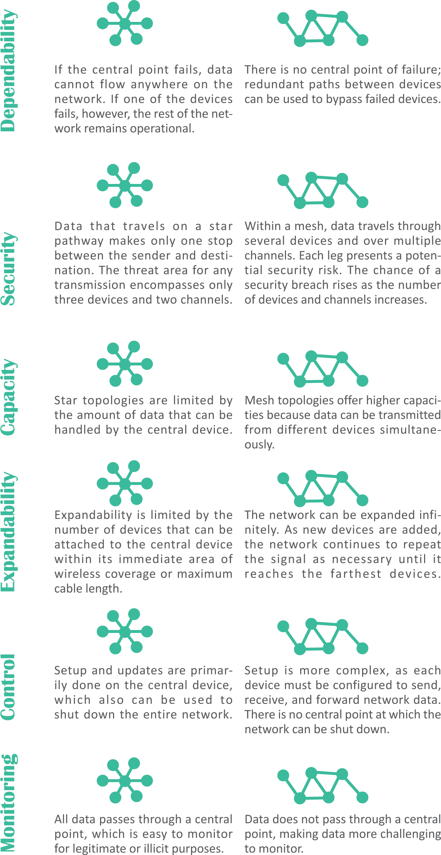
Network Topology (2 of 2)

Slide 23
Network Nodes (1 of 3)
Any device on a network is called a node
Devices on a network are classified as DTEs or DCEs
DTE stands for data terminal equipment and can be any device that stores or generates data
DCE stands for data communication equipment; these devices control the speed of data over networks, convert signals from cables to wireless, check for corrupted data, and route data to its destination

Slide 24
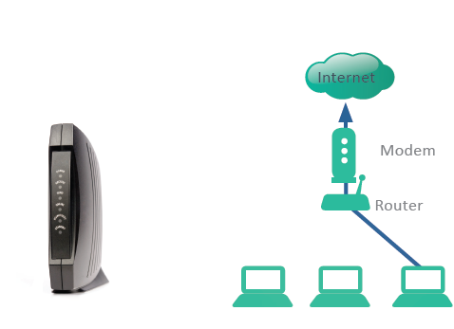
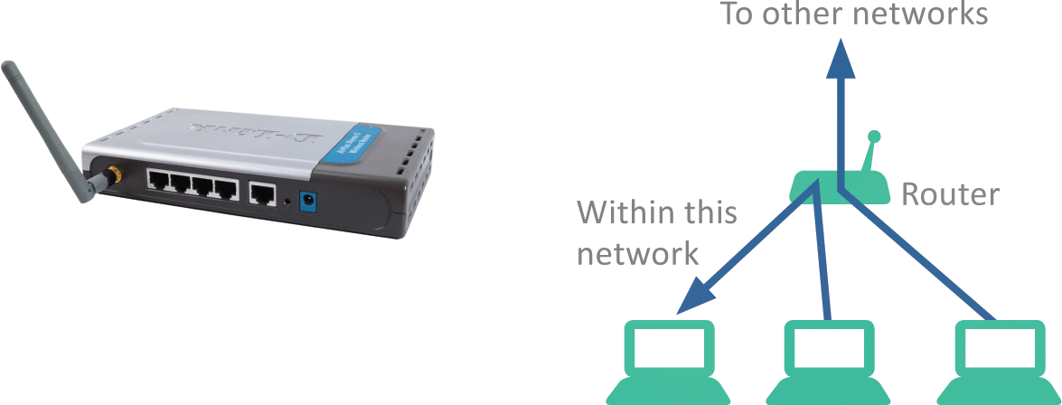
Network Nodes (2 of 3)
A router is a device that controls the flow of data within a network and also acts as a gateway to pass data from one network to another
A modem contains circuitry that converts the data-carrying signals from a digital device to signals that can travel over various communications channels

Slide 25
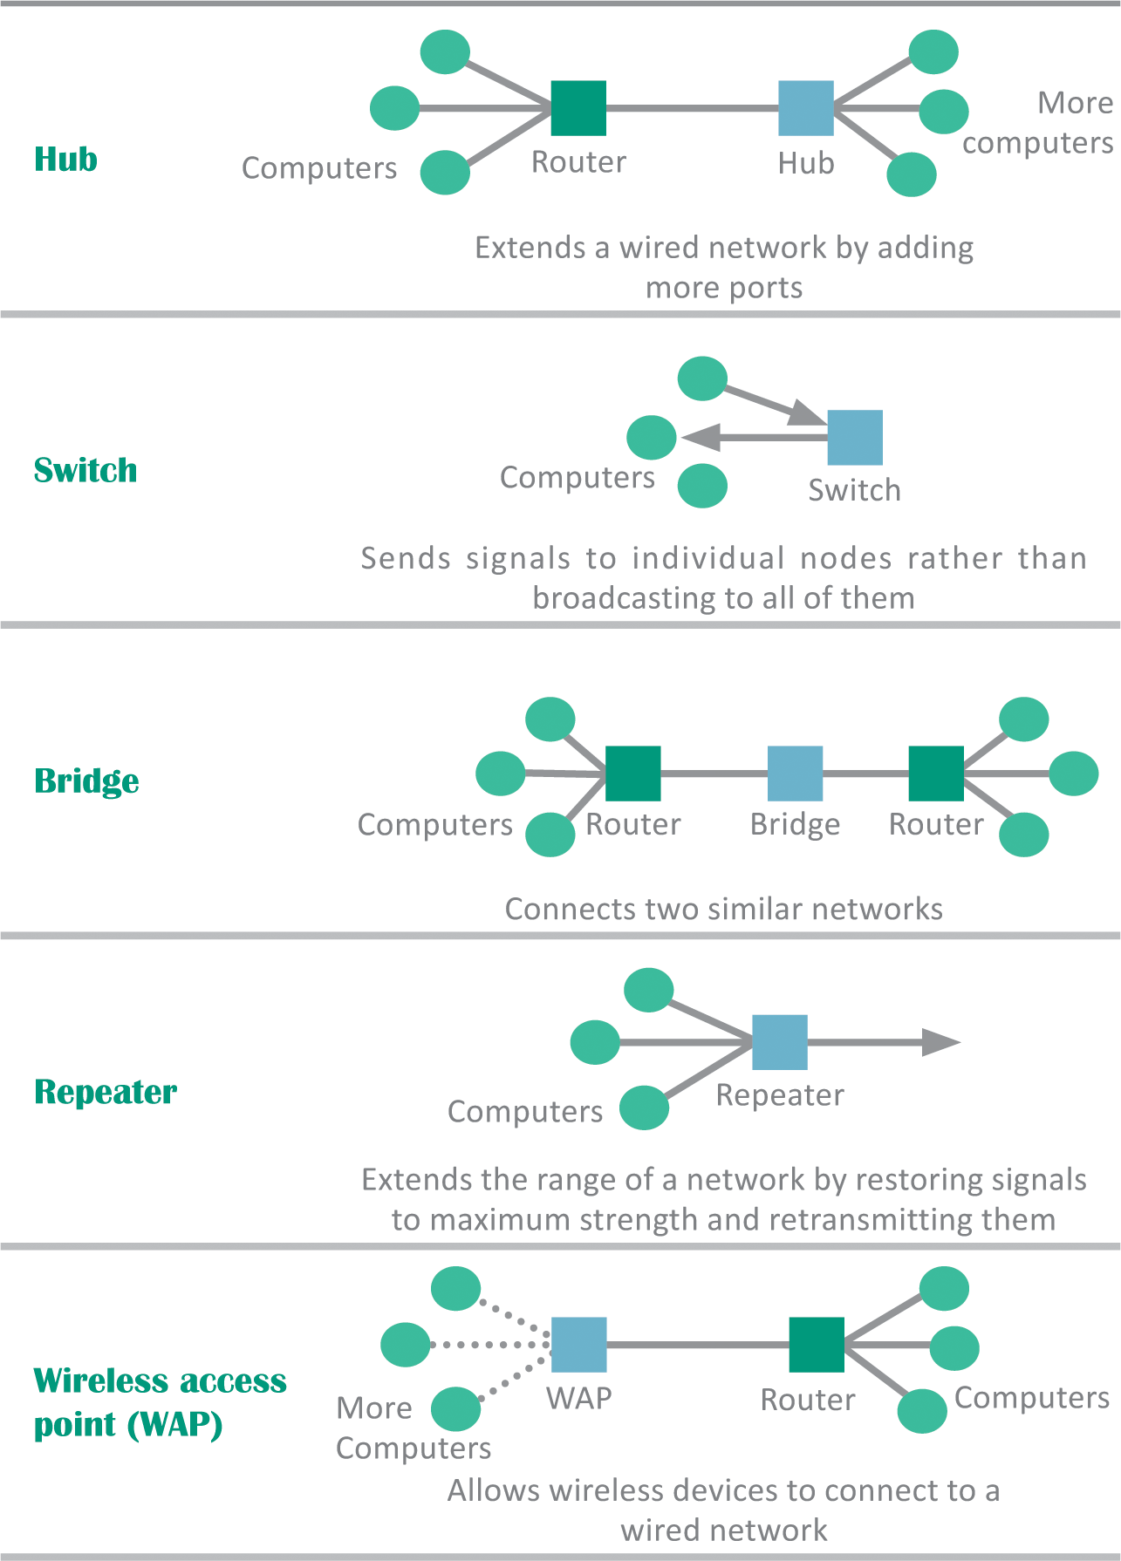
Network Nodes (3 of 3)
DCEs such as repeaters, switches, and hubs can extend the range of your home network

Slide 26
Communication Protocols (1 of 3)
In the context of networks, a communication protocol refers to a set of rules for efficiently transmitting data from one network node to another
This process is called handshaking
Networks use more than one protocol, and the collection of protocols for a network is referred to as a protocol stack

Slide 27
Communication Protocols (2 of 3)
PHYSICAL PROTOCOLS
Specify cable and signal standards for the channels that carry data
TRANSPORT PROTOCOLS
Make sure data gets to its destination by establishing standards for dividing data into chunks, assigning addresses, and correcting errors
ARRIVAL PROTOCOLS
Convert data into standard formats that can be used by applications, such as email, Web browsers, and Skype

Slide 28
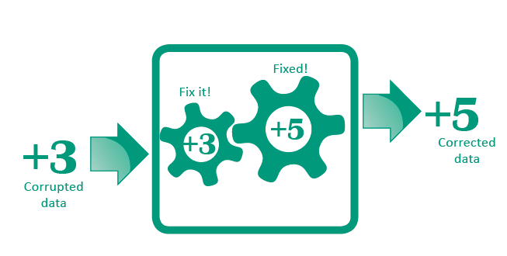
Communication Protocols (3 of 3)
Error correction is one of the responsibilities of communication protocols
Digital networks—those that transmit digital signals—can be easily monitored to determine if interference has corrupted any signals

Slide 29
Section B: The Internet
Background
Internet Infrastructure
Packets
Internet Addresses
Domain Names

Slide 30
Section B: Objectives (1 of 2)
Briefly describe how the Internet developed from the ARPANET
Explain the state of Internet governance and funding
Draw a diagram showing the interrelationship among the three tiers of Internet service providers
Describe how packets are created and how they are carried on packet-switching networks
State the roles of TCP, IP, and UDP

Slide 31
Section B: Objectives (2 of 2)
Identify IPv4 and IPv6 addresses
Explain the differences between static addresses and dynamic addresses
Draw a diagram illustrating how a router deals with private and public IP addresses
List at least five top-level domains
Explain the role of the domain name system and why it is one of the Internet’s vulnerabilities

Slide 32
Background (1 of 5)
The history of the Internet begins in 1957
In a response to the Soviet Union launching Sputnik, the first man-made satellite, the U.S. government resolved to improve its scientific and technical infrastructure
One of the resulting initiatives was the Advanced Research Projects Agency (ARPA)

Slide 33
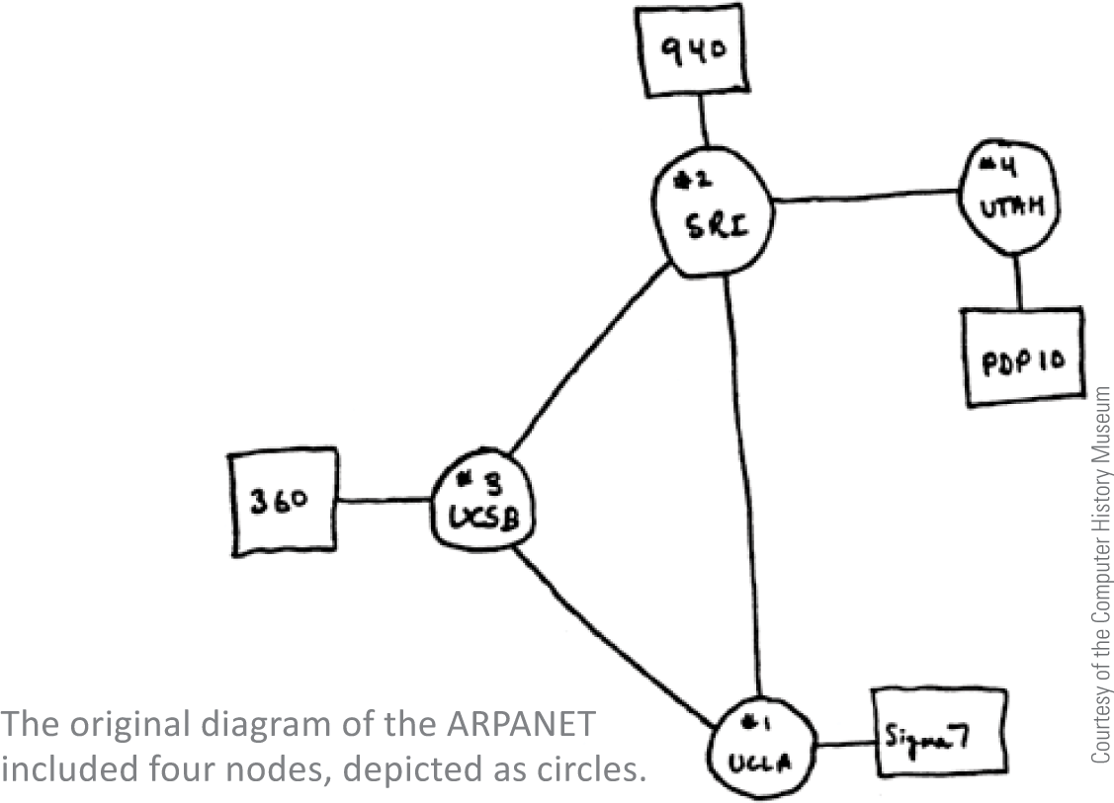
Background (2 of 5)
ARPA designed a project to help scientists communicate and share valuable computer resources, and called The ARPANET
The ARPANET, created in 1969, connected computers at UCLA, the Stanford Research Institute, the University of Utah, and UC California at Santa Barbara

Slide 34
Background (3 of 5)
Early Internet pioneers used primitive command-line user interfaces to send email, transfer files, and run scientific calculations on Internet supercomputers
In the 1990s, software developers created new user-friendly Internet access tools, and Internet accounts became available to anyone willing to pay a monthly subscription fee

Slide 35
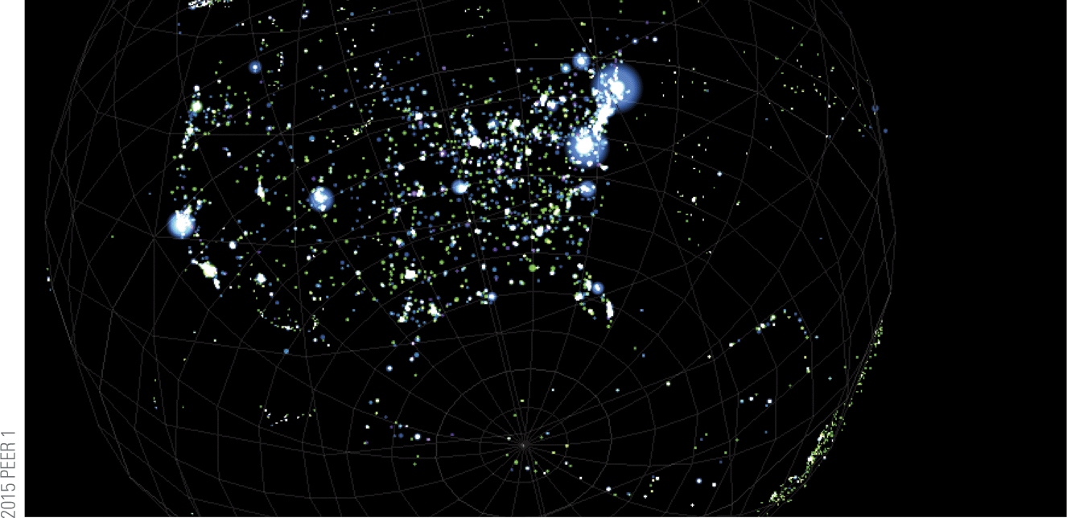
Background (4 of 5)
Today’s Internet, with an estimated 500 million nodes and more than 3 billion users, is huge
It is estimated that the Internet handles more than two exabytes of data every day; an exabyte is 1.074 billion gigabytes – a nearly unimaginable amount of data!

Slide 36
Background (5 of 5)
In theory, no single person, organization, company, or government runs the Internet
Internet governance is simply a set of shared protocols, procedures, and technologies that evolve through common agreement among network providers
The organization that supervises internet addressing is ICANN, the Internet Corporation for Assigned Names and Numbers

Slide 37
Internet Infrastructure (1 of 3)
The way networks fit together is referred to as the Internet Infrastructure
Tier 1 networks, such as AT&T, CenturyLink, Verizon, and NTT Communications represent the top of the Internet hierarchy and form the Internet backbone, a system of high-capacity routers and fiber-optic communication links providing the main routes for data speeding across the Internet
Networks that form the Internet are maintained by Internet service providers (ISPs)
ISPs exchange data at Internet exchange points (IXPs)

Slide 38
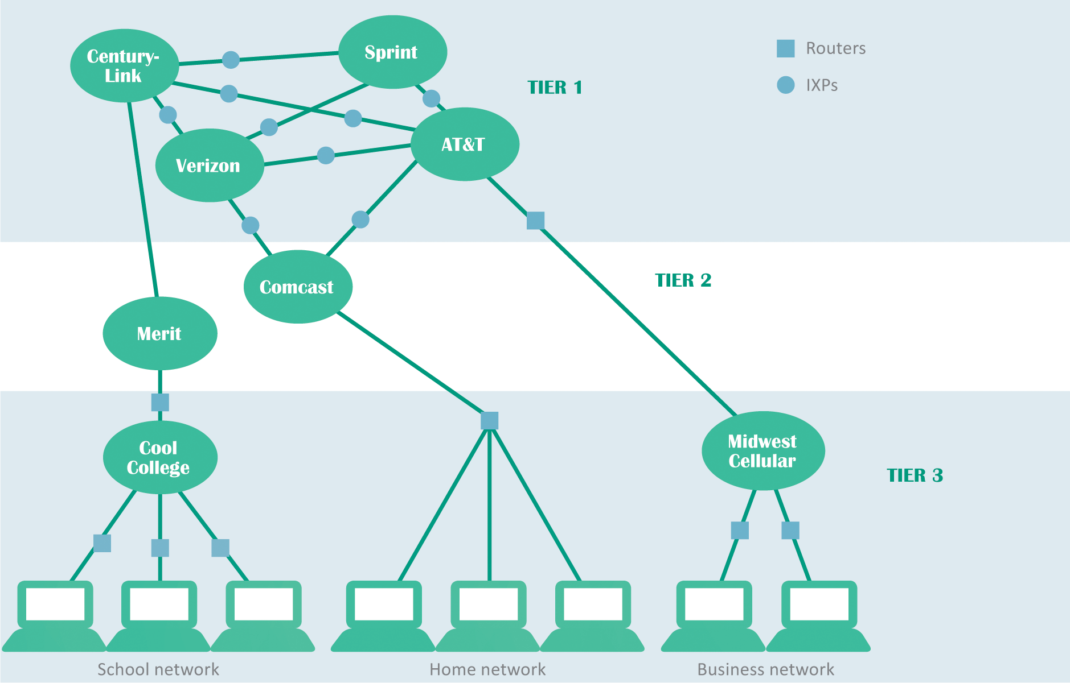
Internet Infrastructure (2 of 3)

Slide 39
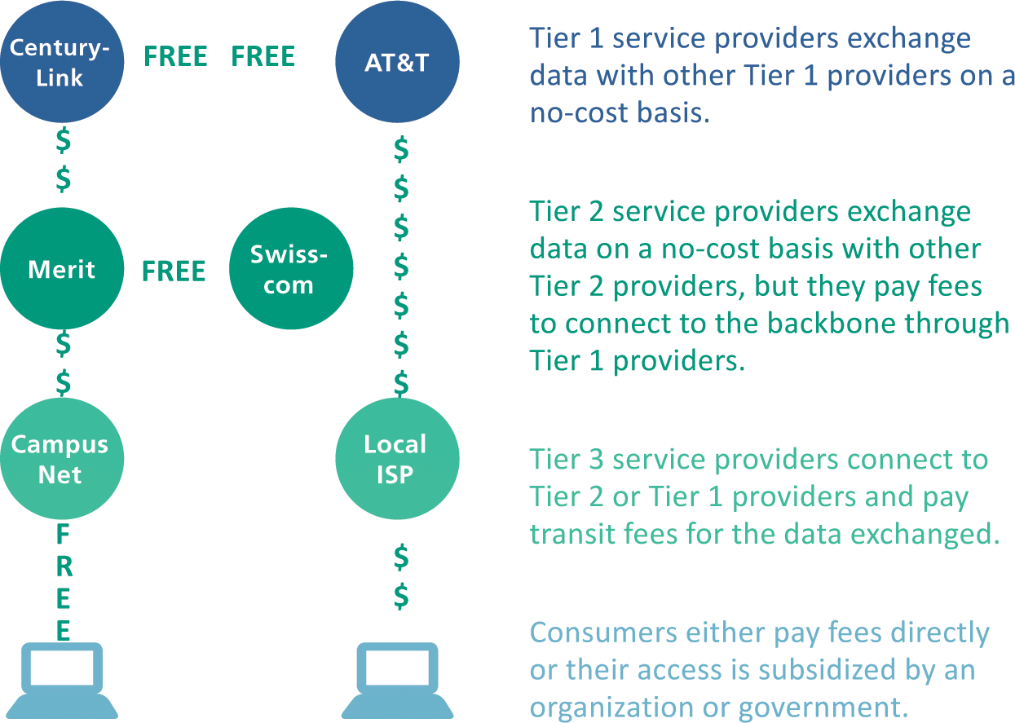
Internet Infrastructure (3 of 3)
The internet is not free; ISPs make a substantial investment in equipment and infrastructure to connect consumers
Tier 1 ISPs own and maintain millions of dollars of data communication equipment

Slide 40
Packets (1 of 6)
A packet is a parcel of data that is sent across a computer network; when packets reach their destination, they are reassembled into the original message according to their sequence numbers

Slide 41

Packets (2 of 6)
Messages divided into equal-size packets are easier to handle than an assortment of small, medium, large, and extra large files.

Slide 42
Packets (3 of 6)
Communication networks use a technology called circuit switching, which establishes a private link between one telephone and another for the duration of a call
A more efficient alterative to this process is packet switching technology, which divides a message into several packets that can be routed independently to their destination

Slide 43
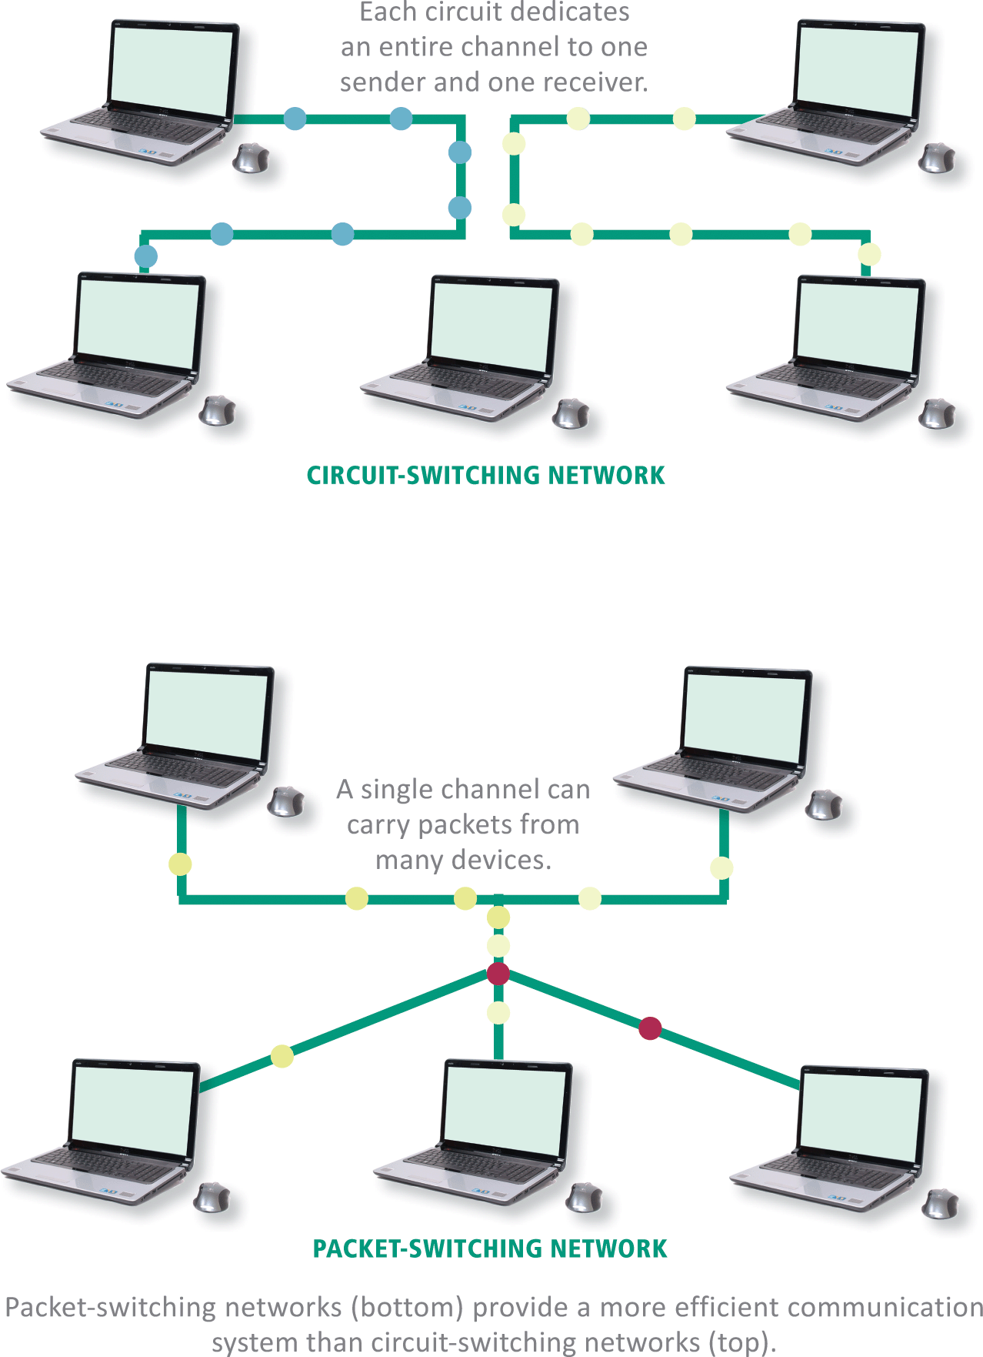
Packets (4 of 6)

Slide 44
Packets (5 of 6)
One of the core Internet protocols, TCP (Transmission Control Protocol) is responsible for dividing files into chunks, adding headers containing information for reassembling packets in their original order, and verifying that the data was not corrupted while in transit (a process called error checking)
UDP (User Datagram Protocol) is an alternative transport protocol which is faster than a TCP but does not perform error checking and cannot reorder packets

Slide 45
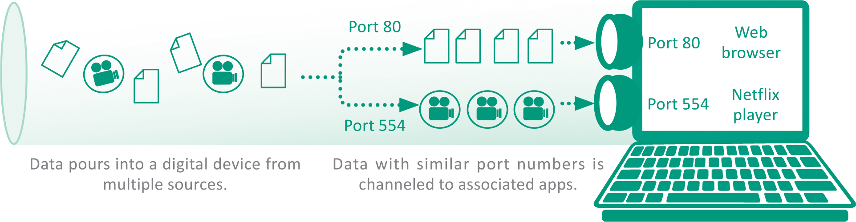
Packets (6 of 6)
A communication port (usually referred to simply as a port) is a virtual end point for data entering and leaving a digital device
Communication ports are not a physical circuit, but rather an abstract concept of a doorway, an opening, or a portal through which data flows

Slide 46
Internet Addresses (1 of 3)
Internet Addresses are controlled by IP (Internet Protocol), which is part of the Internet protocol suite
Many devices on the Internet have permanently assigned IP addresses called static addresses
IP defines two sets of addresses: IPv4 and IPv6
IPv4 – (Internet Protocol version 4); is the Internet address standard; uses 32-bit addresses to identify Internet connected devices
IPv6 – (Internet Protocol version 6); uses 128 bits for each address; produces billions and billions of unique Internet addresses

Slide 47
Internet Addresses (2 of 3)
Internet addresses that are temporarily assigned to a device are called dynamic addresses
IP addresses can be assigned by a network administrator, but more commonly they are automatically assigned by DHCP (Dynamic Host Configuration Protocol)
A private IP address can be allocated by any network without supervision from ICANN – but it cannot be used to send data over the Internet; it’s not routable

Slide 48
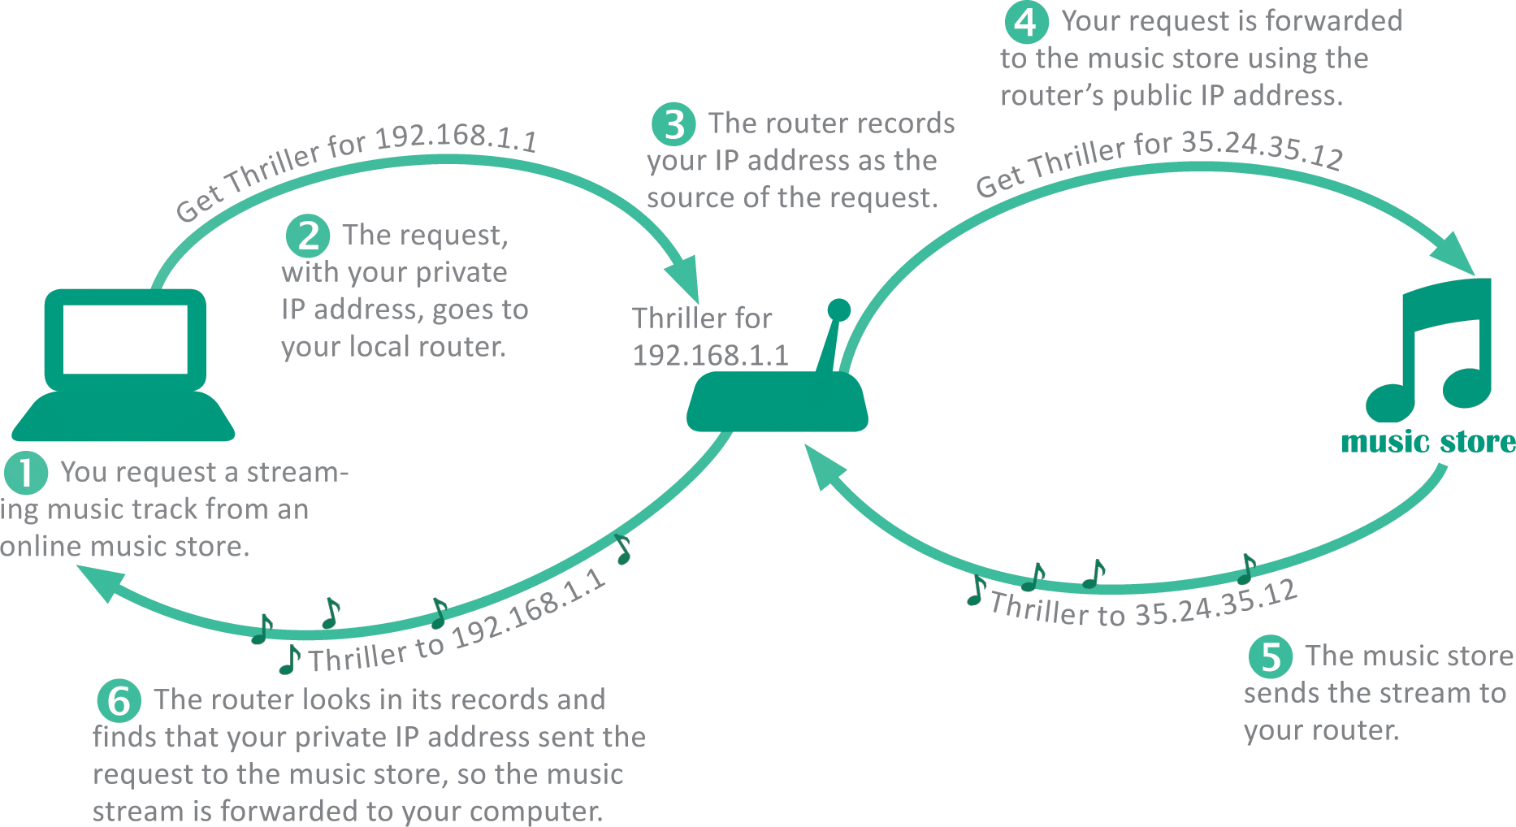
Internet Addresses (3 of 3)
Because a private IP address cannot be routed over the Internet a local router connects instead
The local router has a public IP address that is routable over the Internet

Slide 49
Domain Names (1 of 3)
It’s hard to remember the string of numbers in an IP address; most Internet destinations also have an easy-to-remember domain name, such as nike.com
The mechanism for tracking domain names and their corresponding IP addresses is called the domain name system (DNS)
A domain name ends with an extension that indicates its top-level domain, such as .edu or .org
Domain name servers are scattered around the world and maintain lists of all domain names and their corresponding IP addresses

Slide 50
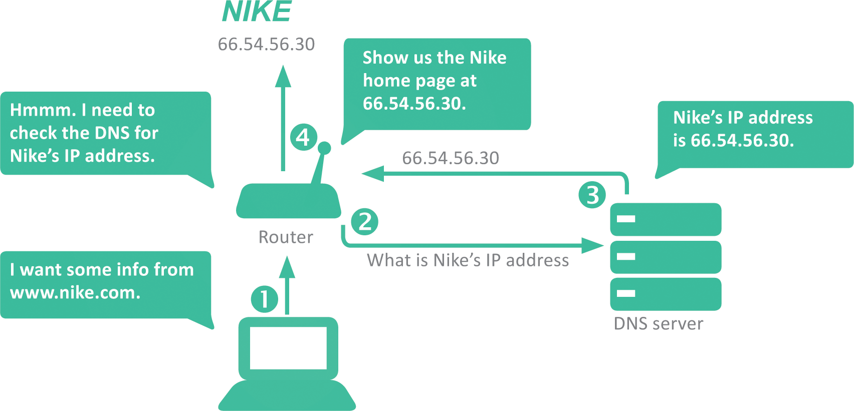
Domain Names (2 of 3)

Slide 51
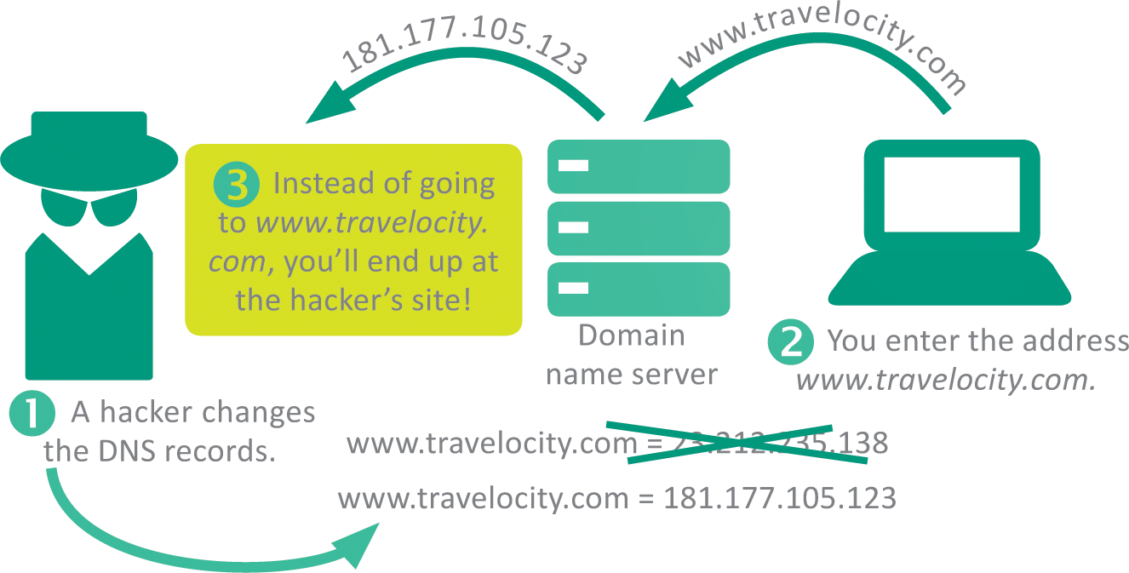
Domain Names (3 of 3)
Altering DNS records can change the destination of email, browser connections, and download requests
Unauthorized changes to the DNS are called DNS spoofing

Slide 52
Section C: Internet Access
Connection Basics
Cable Internet Service
Telephone Network Internet Service
Satellite Internet Service
Mobile Broadband Service
Wi-Fi Hotspots

Slide 53
Section C: Objectives (1 of 2)
List three acceptable speeds for the following: basic Skype video calls, streaming standard-definition movies, and viewing YouTube videos
Explain the significance of asymmetric Internet connections
Define latency and state the type of Internet service that it affects most negatively
List online activities that are most affected by jitter and packet loss

Slide 54
Section C: Objectives (2 of 2)
Name three tools that you can use to troubleshoot an Internet connection
Explain the pros and cons of fixed, portable, and mobile Internet access
Rank each type of Internet service according to speed, then rank them according to dependability
Draw diagrams of the infrastructures for cable, dial-up, DSL, mobile broadband, and Wi-Fi hotspot Internet services
Discuss why mobile Internet access is globally the most popular way to connect to the Internet

Slide 55
Connection Basics (1 of 7)
Data travels over the Internet at an incredible speed, but that speed varies; some Internet services are faster than others
It is easy to check the speed of your Internet connection by running a few online tests

Slide 56
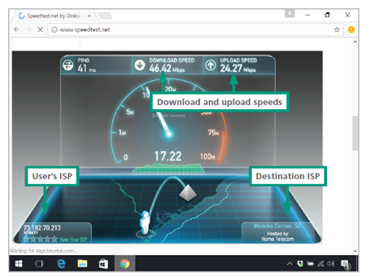
Connection Basics (2 of 7)
This speed test measured the rate of data flowing between the user’s ISP in Macon, GA, and a Comcast server in Moncks Corner, SC.

Slide 57
Connection Basics (3 of 7)
The most common measurement of connection speed is the amount of data that can be transmitted in a specified time; technically, it is a measure of capacity
SERVICE | Recommended Download | Recommended Upload
Skype video calling and screen sharing | 300 Kbps | 300 Kbps
Skype video calls (HD) | 1.5 Mbps | 1.5 Mbps
Skype three-person group calling | 2 Mbps | 512 Kbps
Netflix movie on a laptop computer | 1 Mbps
Netflix SD movie on a TV | 2 Mbps
Netflix 720p HD movie | 4 Mbps
Netflix "best video and audio experience" | 5 Mbps
YouTube basic videos | 500 Kbps
YouTube movies, TV shows, and live events | 1 Mbps
Amazon Prime Instant Video (SD) | 900 Kbps
Amazon Prime Instant Video (HD) | 3.5 Mbps
Netflix and Amazon 4K Streaming Video | 15-25 Mbps

Slide 58
Connection Basics (4 of 7)
ISPs control connection speeds based on the service plan you’ve selected
Your bandwidth cap is the top speed allowed by your plan
During peak times, ISPs can place further limits on speed, a process called bandwidth throttling
When Internet upload speed differs from download speed, you have an asymmetric connection
When upload and download speeds are the same, you have a symmetric connection

Slide 59
Connection Basics (5 of 7)
Ping is utility software designed to measure responsiveness
Ping rate indicates how quickly data can reach a server and bounce back to you
Latency is the elapsed time for data to make a round-trip from point A to point B and back to point A
Jitter measures the variability of packet latency caused when network traffic and interference can delay packets and create erratic data flow
Packet loss refers to data that never reaches its destination or gets discarded because it arrives too late

Slide 60
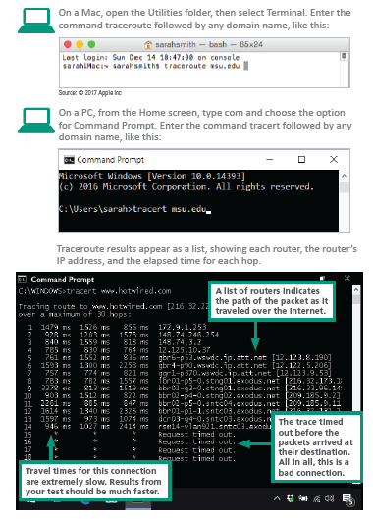
Connection Basics (6 of 7)
To determine whether or not your slow Internet connection is caused by your ISP or your computer you can use a Traceroute, a network diagnostic tool that lists each router and server

Slide 61
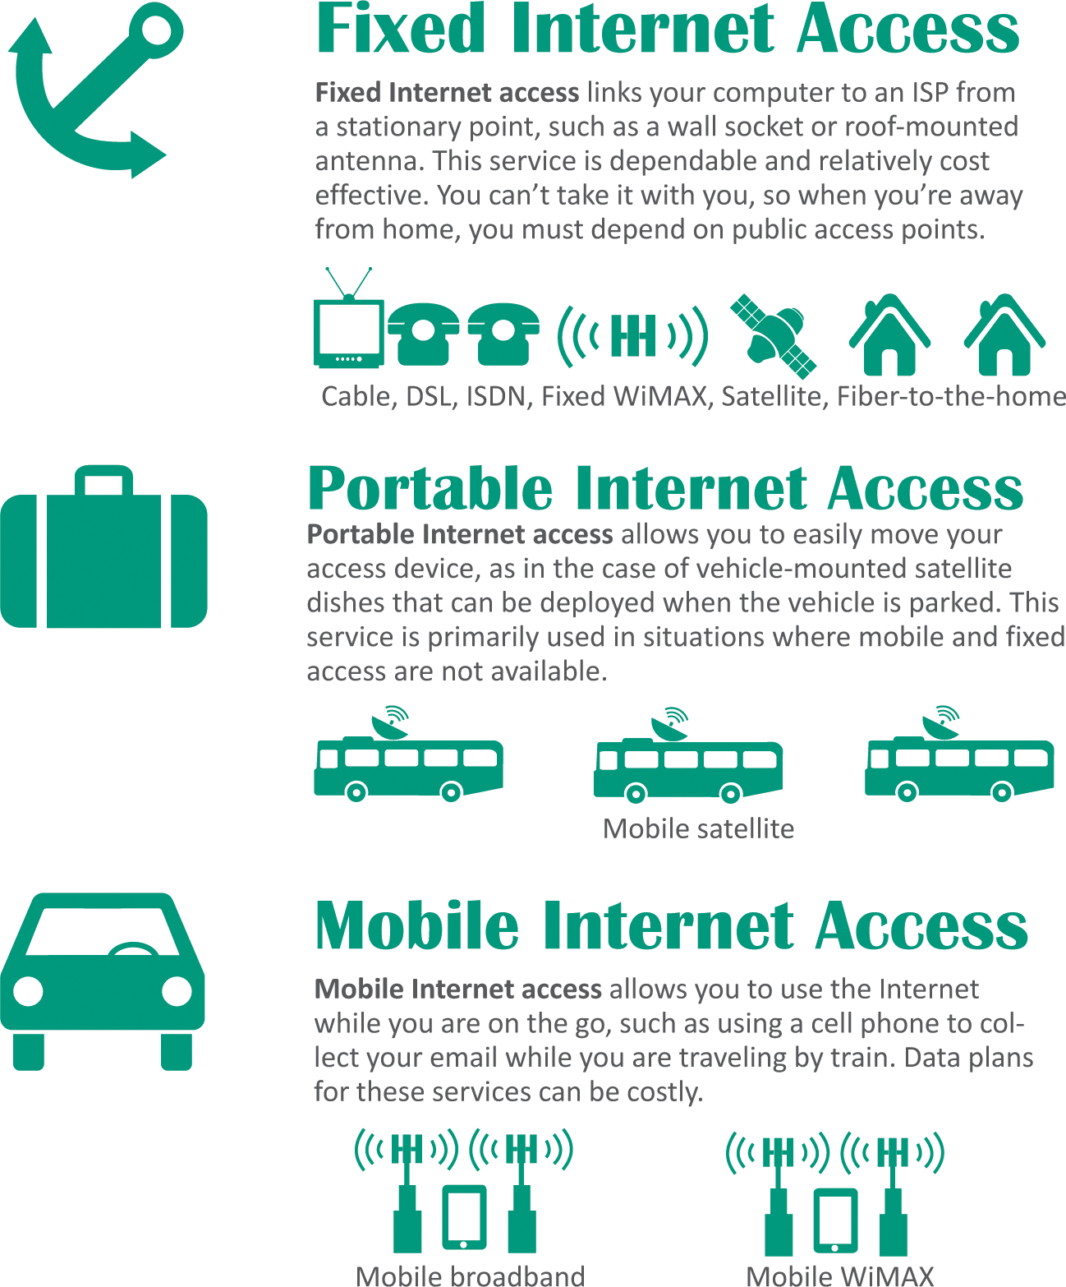
Connection Basics (7 of 7)
Although public Internet access is available in many locations, such as coffee shops and libraries, most consumers like the convenience of having their own Internet connection

Slide 62
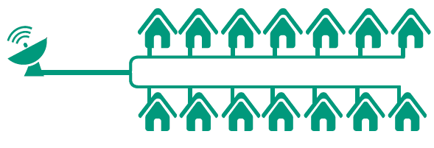
Cable Internet Service (1 of 2)
The gold standard of fixed Internet access is cable Internet service, which is offered by the same companies that supply cable television
CATV stands for community antenna television
With cables branching out from a central location, the topology of a CATV system works well as the infrastructure for a digital data network

Slide 63
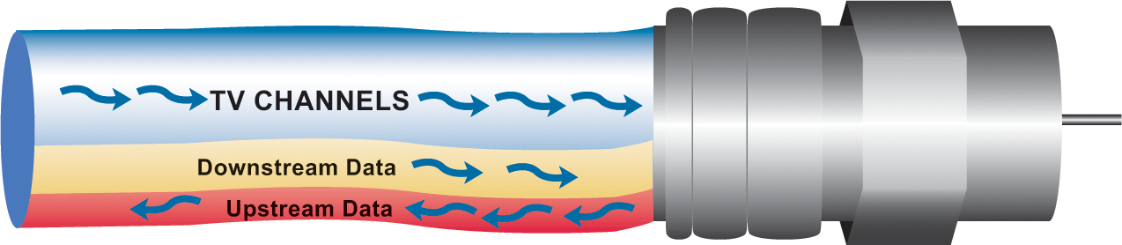
Cable Internet Service (2 of 2)
CATV coaxial and fiber-optic cables have plenty of bandwidth to carry television signals for hundreds of channels in addition to digital data
CATV cables provide bandwidth for television signals, incoming data signals, and outgoing data signals

Slide 64
Telephone Network Internet Service (1 of 4)
Telephone companies offer four types of service: dial-up, ISDN, DSL, and FTTH
A dial-up connection is a fixed Internet connection that uses a voiceband modem and the telephone company’s circuit-switched network to transport data between your computer and your ISP
A voiceband modem converts digital signals from a computer into audible analog signals that can travel over telephone lines

Slide 65
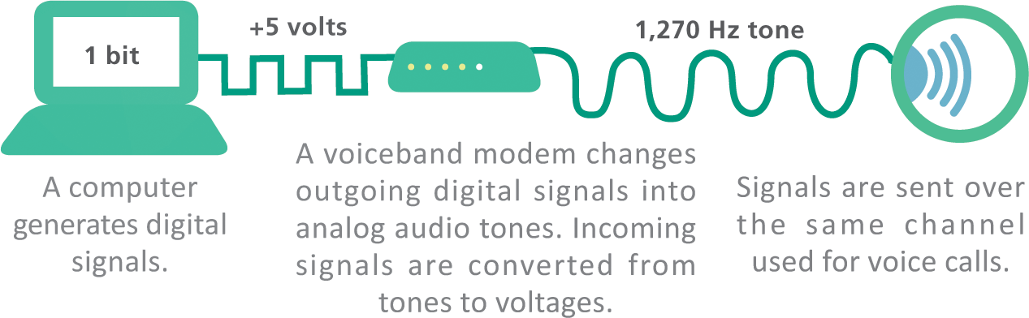
Telephone Network Internet Service (2 of 4)

Slide 66
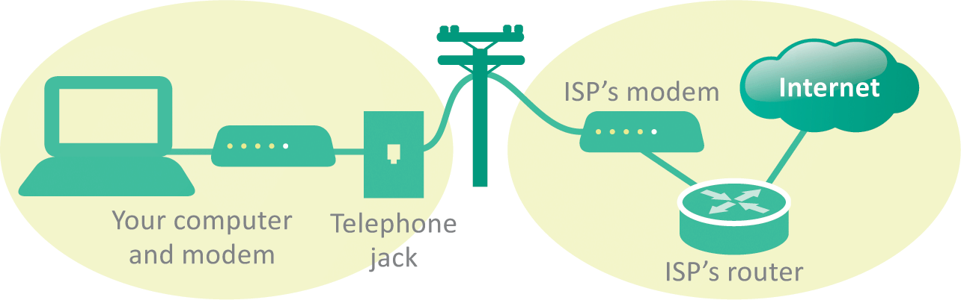
Telephone Network Internet Service (2 of 3)
When you use a dial-up connection, a voiceband modem places a regular telephone call to your ISP; the circuit remains connected for the duration of the call to carry data between your computer and the ISP

Slide 67
Telephone Network Internet Service (3 of 3)
ISDN stands for Integrated Services Digital Network; it divides a telephone line into two channels, one for data and one for voice, by using packet switching
DSL (digital subscriber line) is a high-speed, digital, always-on, Internet access technology that runs over standard phone lines; it’s offered by AT&T’s U-verse service
FTTH (fiber-to-the-home) is the use of high-capacity fiber-optic cables, rather than coaxial cables, to connect homes to broader municipal networks

Slide 68
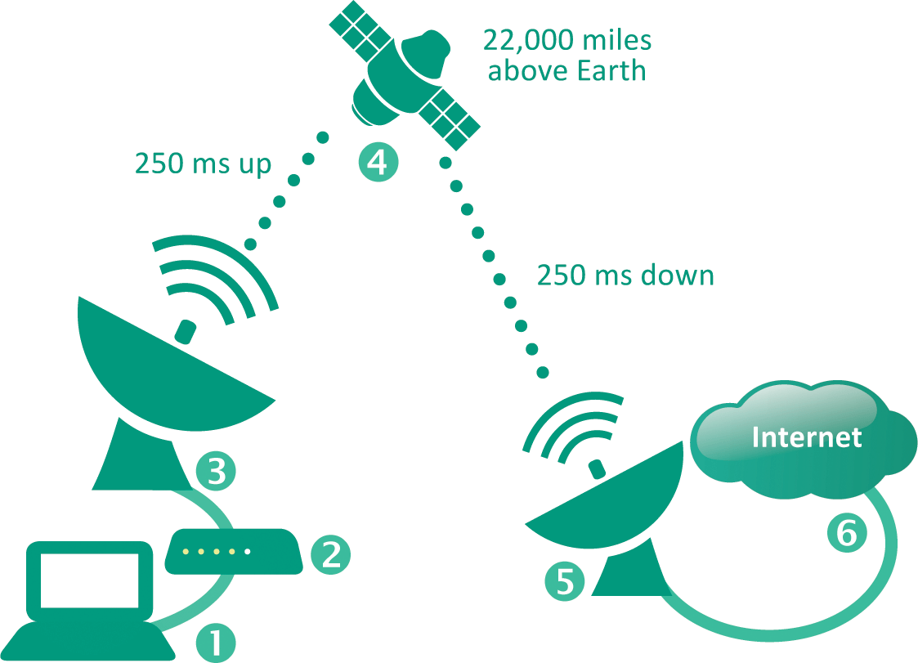
Satellite Internet Service
Satellite Internet service is a means of distributing broadband asymmetric Internet access by broadcasting signals to a satellite
In many rural areas, satellite Internet service is the only alternative to a slow dial-up connection

Slide 69
Mobile Broadband Service (1 of 3)
Mobile broadband service has become so compelling that most of the Web has undergone a visual makeover to fit the requirements of smartphone-sized screens
Cell networks transmit voice and data using radio signals; the signals flow between a device and a cellular radio tower (1), transmitters and receivers on each tower cover a specific area and use a unique frequency; data signals are passed to ground stations (2), where they are forwarded over a packet-switched network to the Internet (3); voice signals may be routed to a circuit-switched network (4)

Slide 70
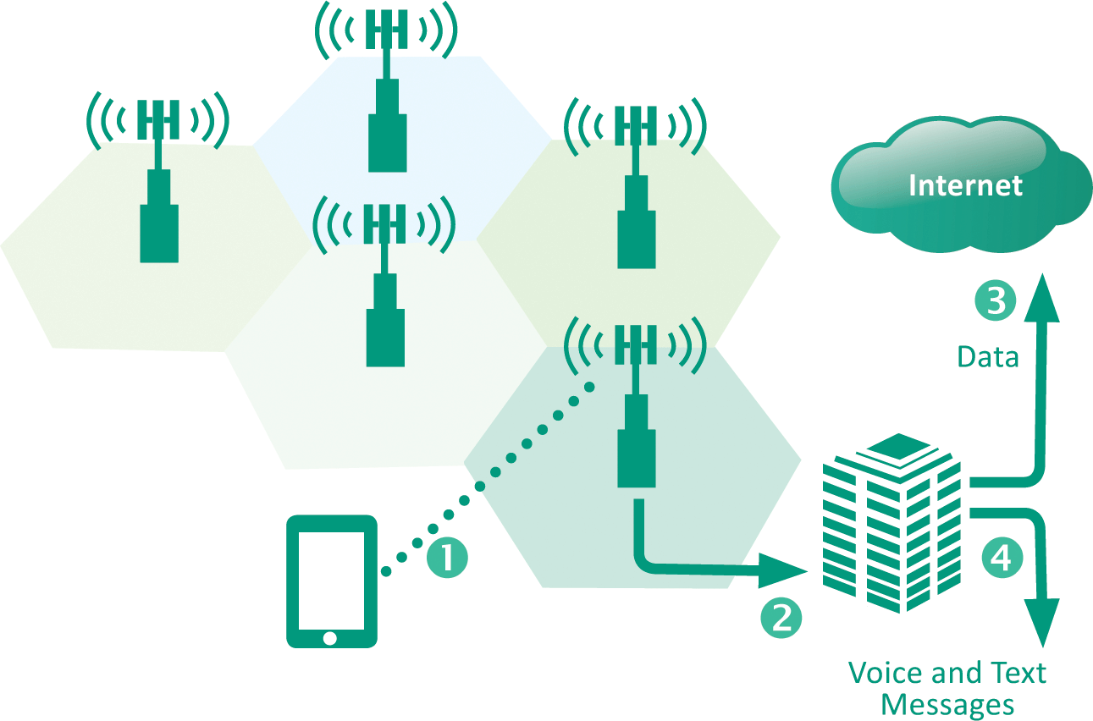
Mobile Broadband Service (2 of 3)

Slide 71
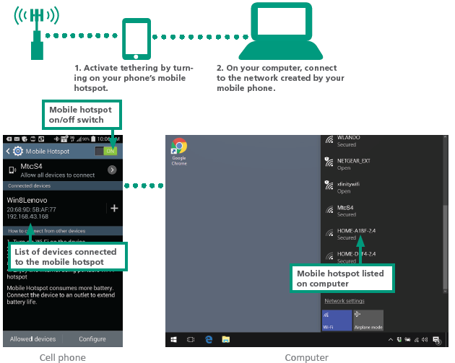
Mobile Broadband Service (3 of 3)
Most of today’s smartphones include a tethering feature that connects wirelessly with other digital devices
Setting up tethering to create a mobile hotspot is easy, just remember though that data sent over the connection accumulates toward your monthly data usage total

Slide 72
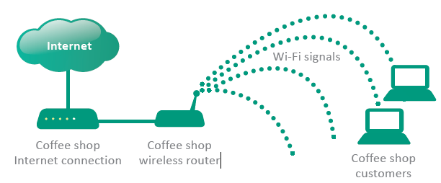
Wi-Fi Hotspots (1 of 3)
A Wi-Fi hotspot is a wireless local area network that offers Internet access to the public
The network has an Internet connection and device called an access point that broadcasts Wi-Fi signals within a range of about 150 feet

Slide 73
Wi-Fi Hotspots (2 of 3)
Low: Browsing. When using a Wi-Fi hotspot for simple browsing activities such as checking sports scores, reading Google news, and looking for directions, your security risk is fairly low if your computer’s antivirus software is up to date.
Low: Using secure sites. Your security risk is low when you are accessing secured Web sites that have addresses beginning with HTTPS. These secured sites, which are used for activities such as online banking, accessing medical records, and making credit card purchases, encrypt the data that you enter to keep it safe from eavesdroppers.

Slide 74
Wi-Fi Hotspots (3 of 3)
MED: File sharing. Eavesdroppers might be able to access the files on your computer if you have file sharing turned on. When using public networks, you should turn file sharing off. You can do so manually if your operating system does not offer that option when you connected.
HIGH: Using unsecured sites. When you log in to unsecured sites while using public Wi-Fi hotspots, a wireless eavesdropper could potentially snag your user ID and password information, then use it later to access your accounts. Logging in to your Webmail account, for example, could be risky if your user ID and password are transmitted over an unsecured connection.

Slide 75
Section D: Local Area Networks
LAN Basics
Ethernet
Wi-Fi
Set Up Your Own Network
Network Monitoring
IoT Networks

Slide 76
Section D: Objectives (1 of 2)
Diagram the components and connection in a typical home LAN
Explain the roles of MAC addresses and IP addresses in local area networks
List five advantages of Ethernet wired network standards
Explain the pros and cons of wireless mesh networks as compared to centralized wireless networks
Compare the speeds and ranges of Ethernet and Wi-Fi

Slide 77
Section D: Objectives (2 of 2)
List five steps for securely configuring a wireless router
State the purpose of an SSID
List four types of wireless encryption
Provide two example scenarios for using RFID tags and NFC tags
List three low-power wireless standards used for IoT networks
Evaluate potential security exposure for data that is collected by IoT networks

Slide 78
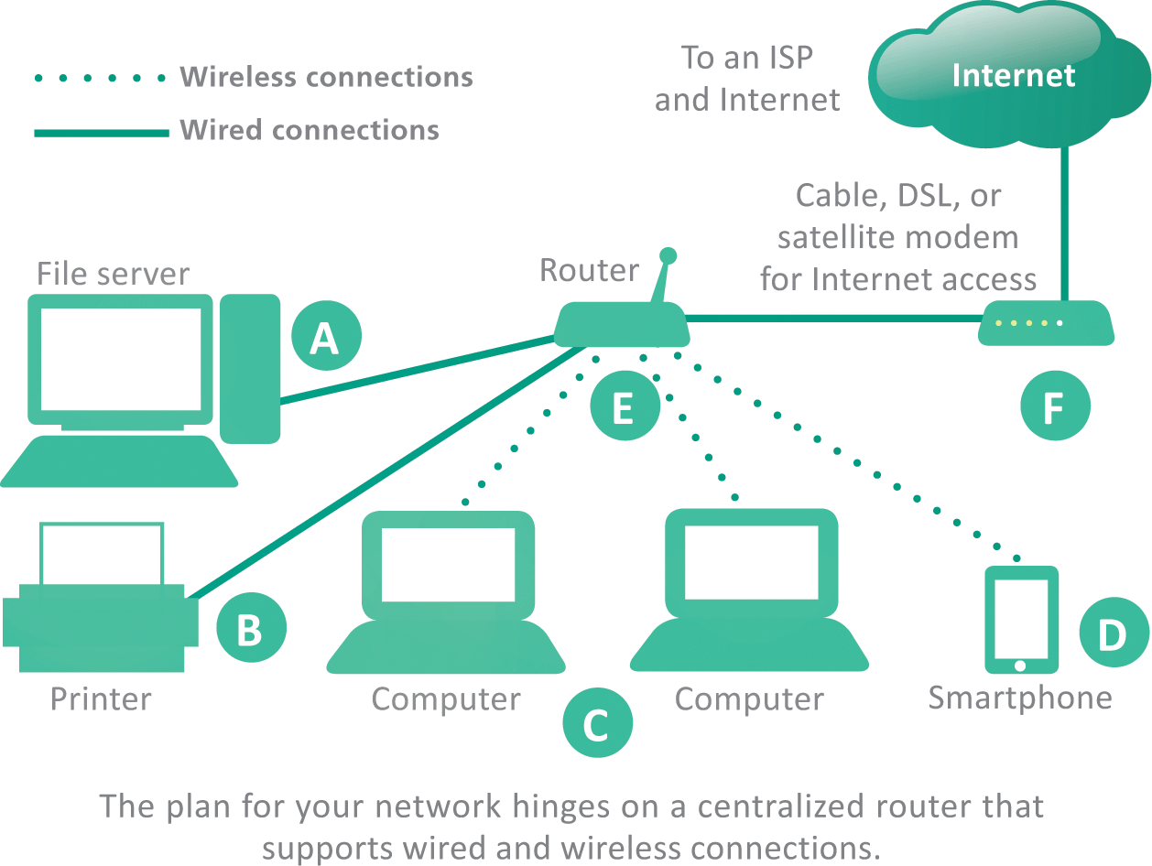
LAN Basics (1 of 2)
Local area networks are often referred to as LANs
They are designed to provide connectivity for devices within a limited area, typically within the premises of a home, office building, business, or school

Slide 79
LAN Basics (2 of 2)
LANs can be classified by their protocols; Ethernet and Wi-Fi are the two most popular
The Windows OS provides a tool for setting up a LAN called a homegroup; this makes it easy to share files among local computers, but does not provide Internet access
Most LANs are set up using a router so that they have proper security and Internet access
The circuitry that enables a device to access a LAN is called a network interface controller (NIC)
NICs contain a MAC address (media access control address) used to identify devices on LANs

Slide 80
Ethernet (1 of 4)
Ethernet is a wired network technology that is defined by IEEE 802.3 standards
Ethernet’s success is attributable to several factors
Easy – it’s easy to understand, implement, manage, and maintain
Secure – the wired connections in an Ethernet LAN are more secure than wireless LAN technologies
Inexpensive – as a nonproprietary technology, Ethernet equipment is available from a variety of vendors; market competition keeps prices low

Slide 81
Ethernet (2 of 4)
Flexible – current Ethernet standards allow extensive flexibility in network configurations
Compatible – Ethernet is compatible with Wi-Fi wireless technology; it’s easy to mix wired and wireless devices on a single network

Slide 82
Ethernet (3 of 4)
Ethernet was originally a bus topology in which computers were all strung along a cable like birds on a power line
Today’s Ethernet LANs are usually arranged in a star topology with computers wired to central switching circuitry that is incorporated in modern routers
Data sent from a computer on the network is transmitted to the router, which then sends the data to the destination device

Slide 83
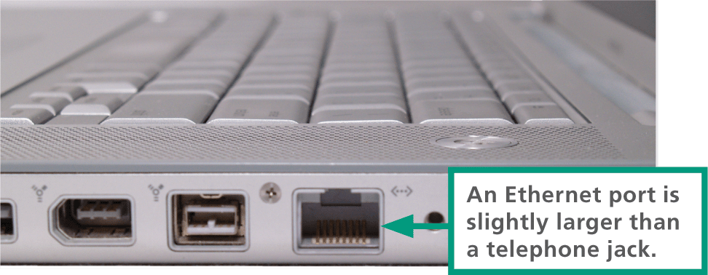
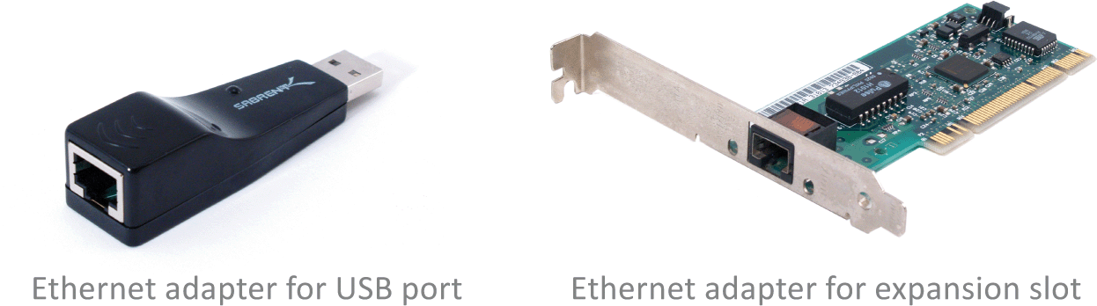
Ethernet (4 of 4)
Many computers have a built-in Ethernet port located on the system case; the port looks very similar to an oversized telephone jack
If you want a wired network connection but your computer has no Ethernet port, you can purchase and install an Ethernet adapter (also called an Ethernet card)

Slide 84
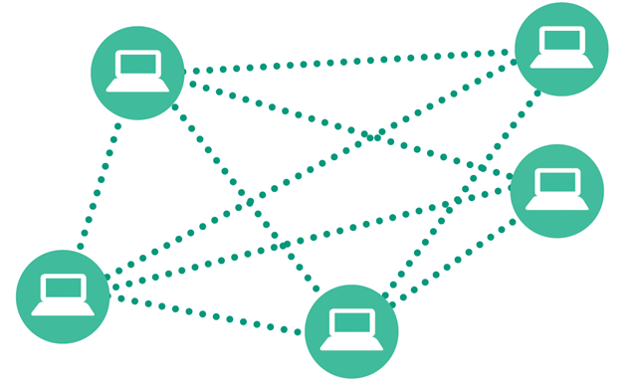
Wi-Fi (1 of 2)
Wireless ad-hoc networks are conceptually simple but provide few security safeguards. This type of connection is best limited to occasional use when you want to temporarily connect two computers to share a few files.

Slide 85
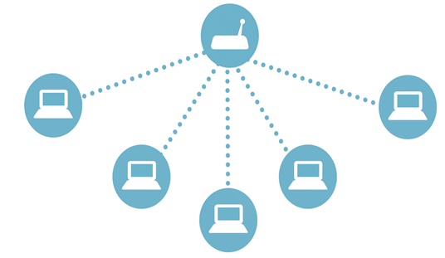
Wi-Fi (2 of 2)
The most common wireless network technology uses a centralized device to handle data that travels from one device to another.

Slide 86
Set Up Your Own Network (1 of 2)
Having your own network is great, but LANs can be a security risk
Here’s how to set up your own safe and secure LAN:
Plug in the router and connect it to your Internet modem
Configure the router
Connect wired and wireless devices
Change the router password
Create an SSID (service set identifier); this will be the name of your wireless network

Slide 87
Set Up Your Own Network (2 of 2)
Activate wireless encryption to scramble and unscramble data
WEP (wired equivalent privacy) is the oldest and weakest wireless encryption protocol
WPA (Wi-Fi Protected Access) and its cousins, WPA2 and PSK, offer more security
Create a wireless encryption key (a network security key or password)
Configure the Guest Network (a second network on your LAN’s router)
Activate DHCP (assigns addresses to each device that joins your network)

Slide 88
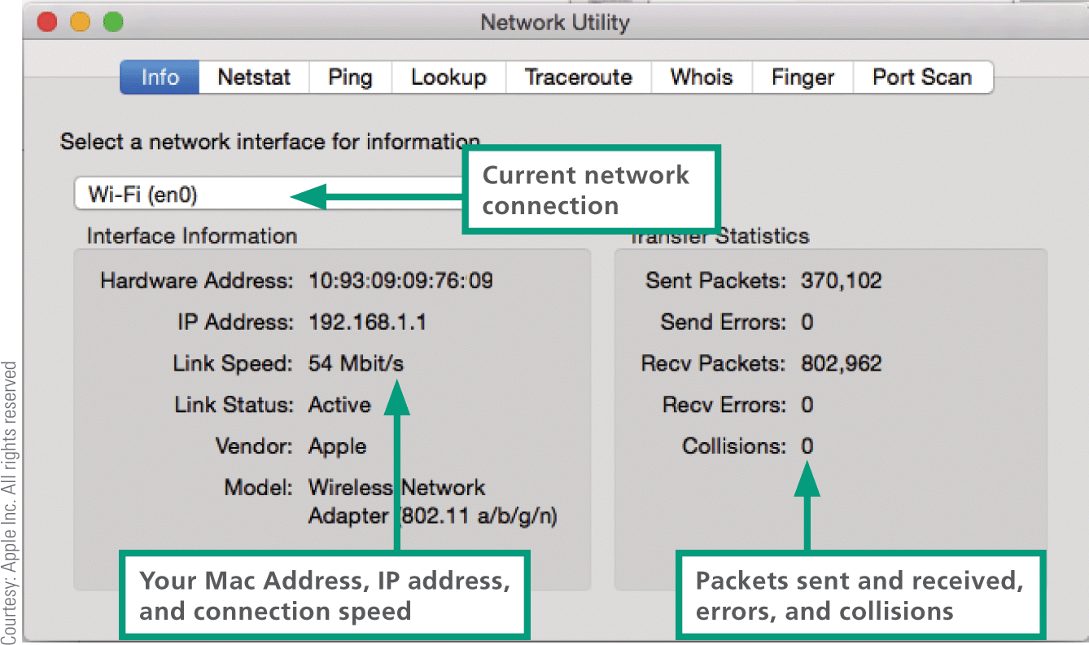
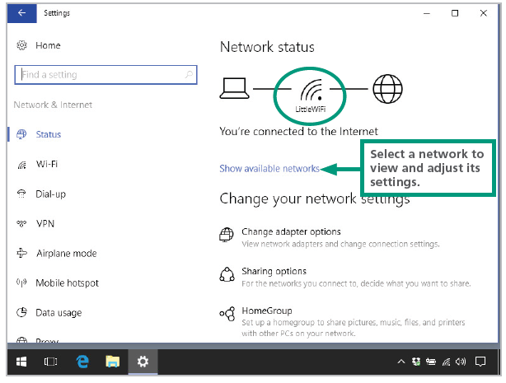
Network Monitoring
When your network has stopped sending and receiving packets, you might be able to correct the problem by turning off your router and Internet modem, waiting a few seconds, and then turning them on again

Slide 89
IoT Networks (1 of 2)
The Internet of Things (IoT) connects active sensors and passive tags to communications networks, making it easy to remotely monitor places and things
Wi-Fi is fairly power hungry, so it’s not an optimal IoT technology
Existing wireless technologies such as RFID and NFC offer potential solutions
Additional low-power short-range technologies developed specifically for IoT networks include Bluetooth Smart, ZigBee, and Z-Wave

Slide 90

IoT Networks (2 of 2)
A sensor, such as a thermometer or heart rate monitor, actively collects data
A tag contains passive data; an RFID tag in a passport, for example, contains personal data, such as the name and birth date that are stored on the tag, which is read electronically
An NFC tag might be attached to merchandise, so that you can tap it with your cell phone to see its price and specifications

Slide 91
Section E: File Sharing
File Sharing Basics
Accessing LAN Files
Sharing Your Files
Internet-based Sharing
Torrents

Slide 92
Section E: Objectives (1 of 2)
List seven factors that control your ability to share files
State the name of the utilities you use to view a list of files on Macs and on Windows
Explain the purpose of network discovery
List three precautions you can take when working with shared files
Define the three types of permissions that can be assigned to shared files

Slide 93
Section E: Objectives (2 of 2)
Describe at least two situations in which FTP would be a useful technology
List two factors that have a negative effect on files stored in the cloud
Draw a diagram that explains how torrents work
Discuss the legal issues that pertain to file sharing technologies, such as Napster and BitTorrent

Slide 94
File Sharing Basics (1 of 2)
File sharing allows files containing documents, photos, music, and more to be accessed from computers other than the one on which they are stored
Sharing can take place within a LAN or across multiple networks, including the Internet

Slide 95
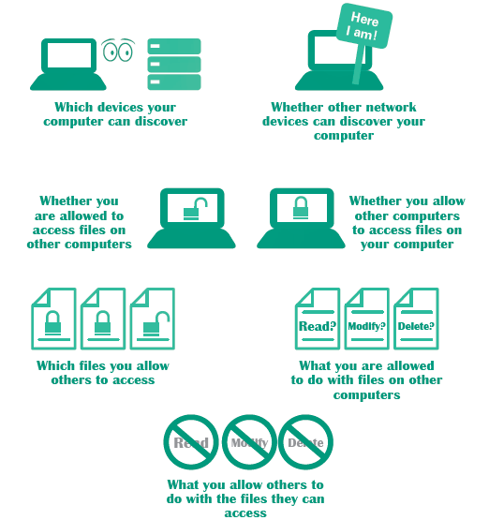
File Sharing Basics (2 of 2)
Your ability to share files with other devices on a network depends on several factors

Slide 96
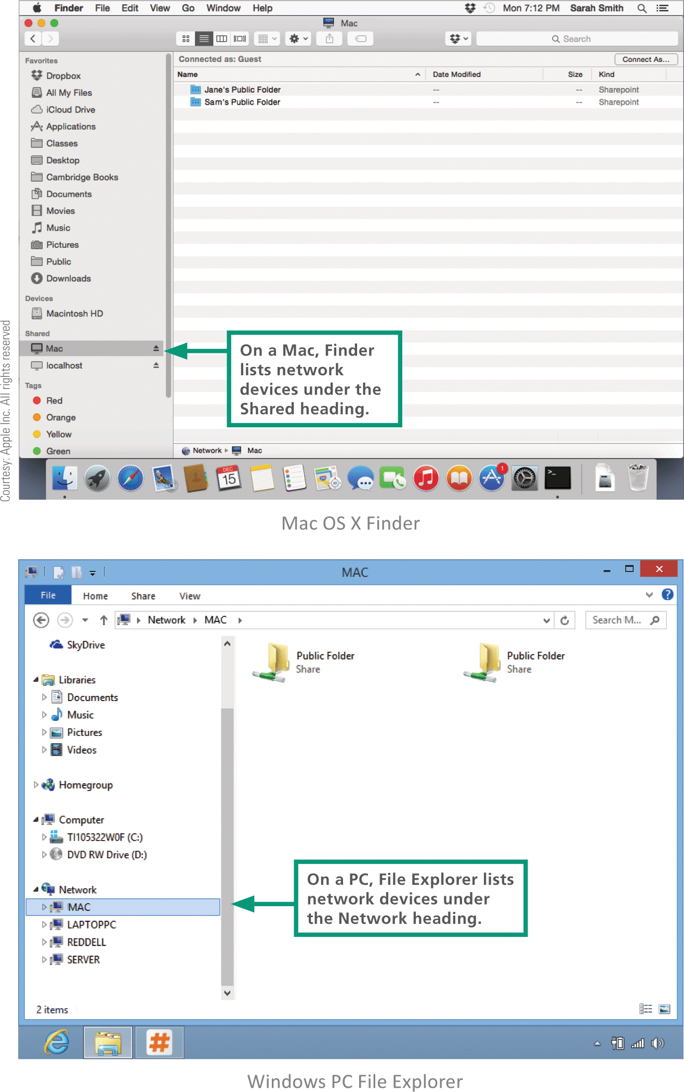
Accessing LAN Files (1 of 2)
To see a list of devices on your network, you can use your OS’s file management utility, such or as Finder of File Explorer

Slide 97
Accessing LAN Files (2 of 2)
The network utilities provided by operating systems automatically detect other devices when network discovery is turned on
Network discovery is a setting that affects whether your computer can see other devices on a network, and whether your computer can be seen by others; it works in different ways on different devices
Mobile devices – the OS may not offer a way to see other devices on a network
Macs – Macos devices have no user-modifiable network discovery settings; offers file sharing settings instead
Windows – Some OSs offer network discovery setting that allows users to turn it off or on

Slide 98
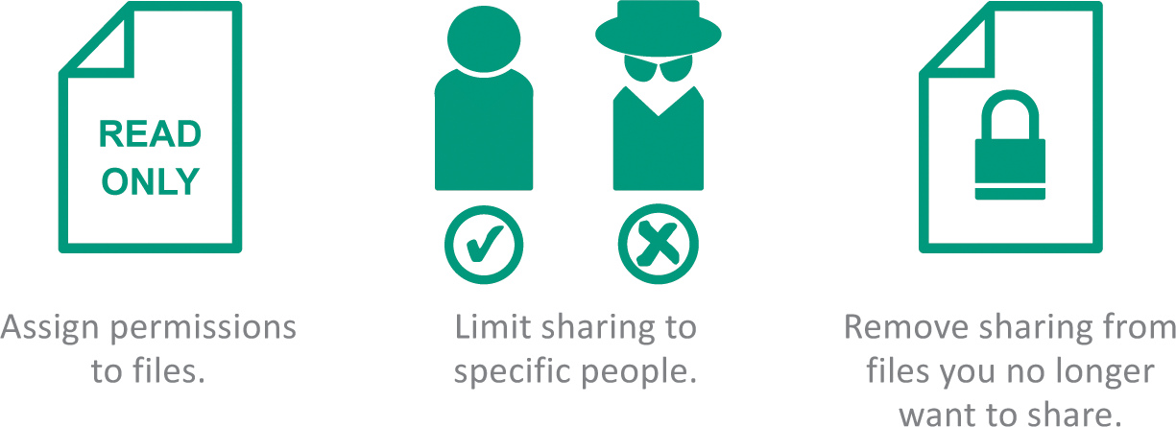
Sharing Your Files
Permissions specify how shared files can be used
Read and write permission – (full control) allows access for opening, viewing, modifying, and deleting files
Read permission – allows authorized people to open a file and view it, but not modify or delete it
Write-only permission – works like drop box, allowing people to put files in one of your folders, but not open, copy, or change any files you have stored there

Slide 99
Internet-Based Sharing (1 of 3)
FTP (File Transfer Protocol) provides a way to transfer files from one computer to another over any TCP/IP network, such as a LAN or the Internet
You can access FTP servers with FTP client software, such as FileZilla, or with a browser
Dropbox and similar file hosting services store files in the cloud

Slide 100
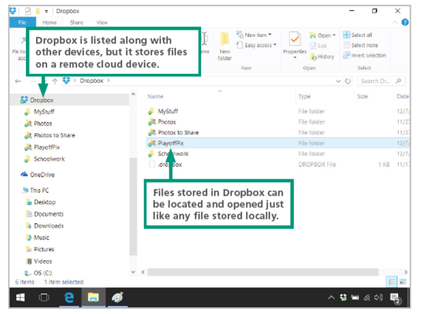
Internet-Based Sharing (2 of 3)
Dropbox can be accessed from the Dropbox.com Web site, or it can be installed as an app on a local device. On a local device, files and folders stored in your Dropbox can be accessed just as if they were stored locally.

Slide 101
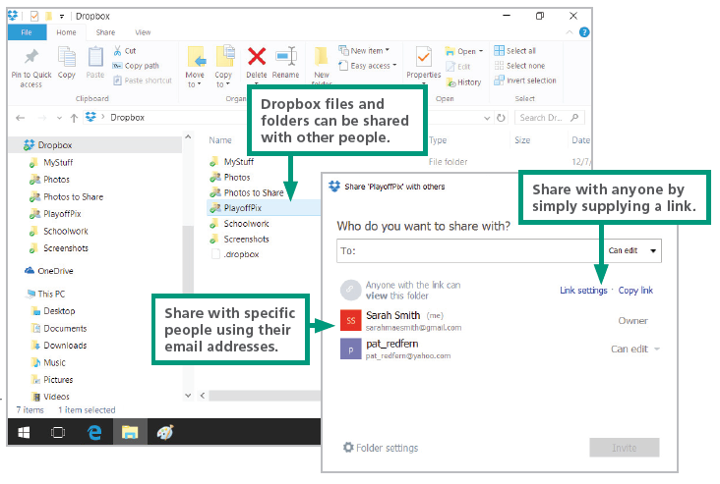
Internet-Based Sharing (3 of 3)

Slide 102
Torrents (1 of 4)
The concept of sharing files over the Internet, that started in the 1990s, spurred development of sophisticated, distributed protocols such as BitTorrent
BitTorrent is a file sharing protocol that distributes the role of a file server across a collection of dispersed computers
A BitTorrent network is designed to reduce the bandwidth bottleneck that occurs when many people attempt to download the same very large file, such as a feature-length film, application software or an interactive 3-D computer game

Slide 103
Torrents (2 of 4)
How a BitTorrent works:
A BitTorrent network server breaks a movie file into pieces and begins to download those pieces to the first computer that requested the movie
As more computers request the file, they become part of a “swarm” that uses peer-to-peer technology to exchange movie segments with each other
After the server has downloaded all the segments to the swarm, its job is complete and it can service other requests

Slide 104
Torrents (3 of 4)
The swarm continues to exchange movie segments until every computer in the swarm has the entire movie

Slide 105
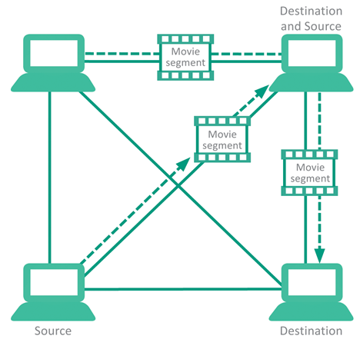
Torrents (4 of 4)
Every user who downloads from a torrent is automatically uploading to other users.

